Slide 1
Analyzing Amazon Sales Data

Slide 2
Objective:
Sales management has gained importance to meet increasing competition and the need
for improved methods of distribution to reduce cost and to increase profits. Sales
management today is the most important function in a commercial and business
enterprise.
Do ETL : Extract-Transform-Load some Amazon dataset and find for me
Sales-trend -> month wise , year wise , yearly_month wise.
Find key metrics and factors and show the meaningful relationships between attributes.
Benefits:
Improved forecasting.
Identifying growth opportunities.
Identifying customer behavior.
Improving operational efficiency.
Identifying seasonal patterns.
Monitoring competition

Slide 3
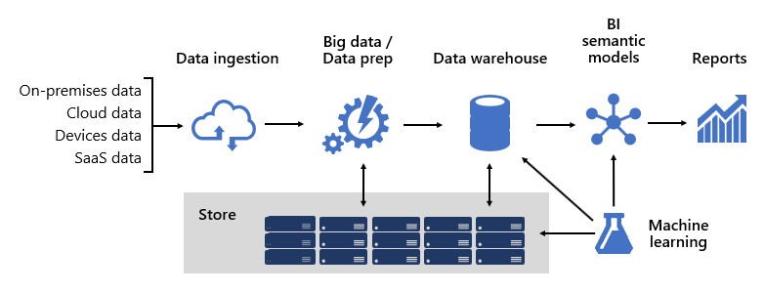
Architecture

Slide 4
Data Analysis Methodology-
Collect and prepare the data: Firstly imported data from given dataset. Then, prepare the data for analysis by cleaning and preprocessing it. That include tasks such as filling in missing values, removing outliers, and transforming the data in various ways.
Explore the data: Begin to explore the data by looking at summary statistics, creating visualizations, and identifying patterns and trends. This can help to understand the data better, and can also help you to identify any issues or problems with the data.
After analyzing that dataset in python then we have imported that data in Power Bi so as to visualize that data in better way.

Slide 5
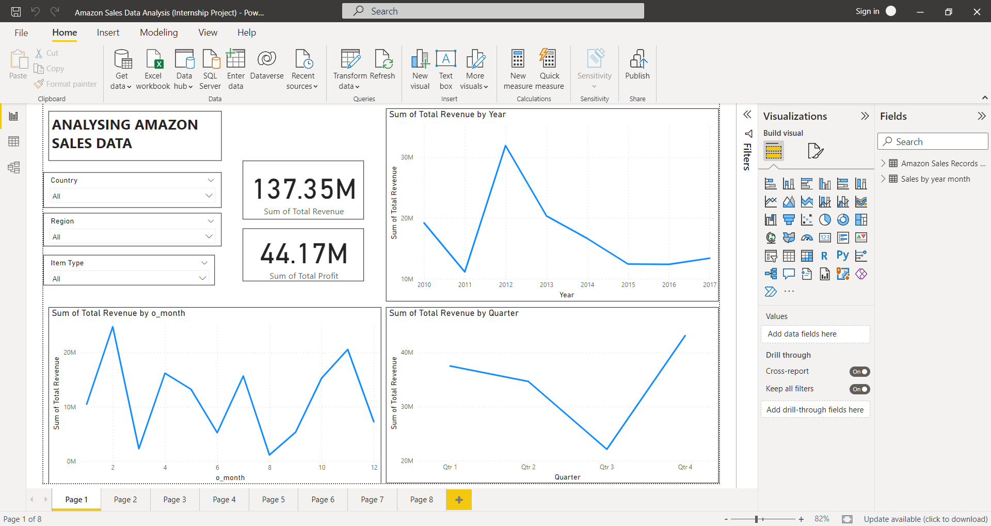
Results:
From this analysis we get clarity regarding sales trend monthly, yearly, quarter wise, etc

Slide 6
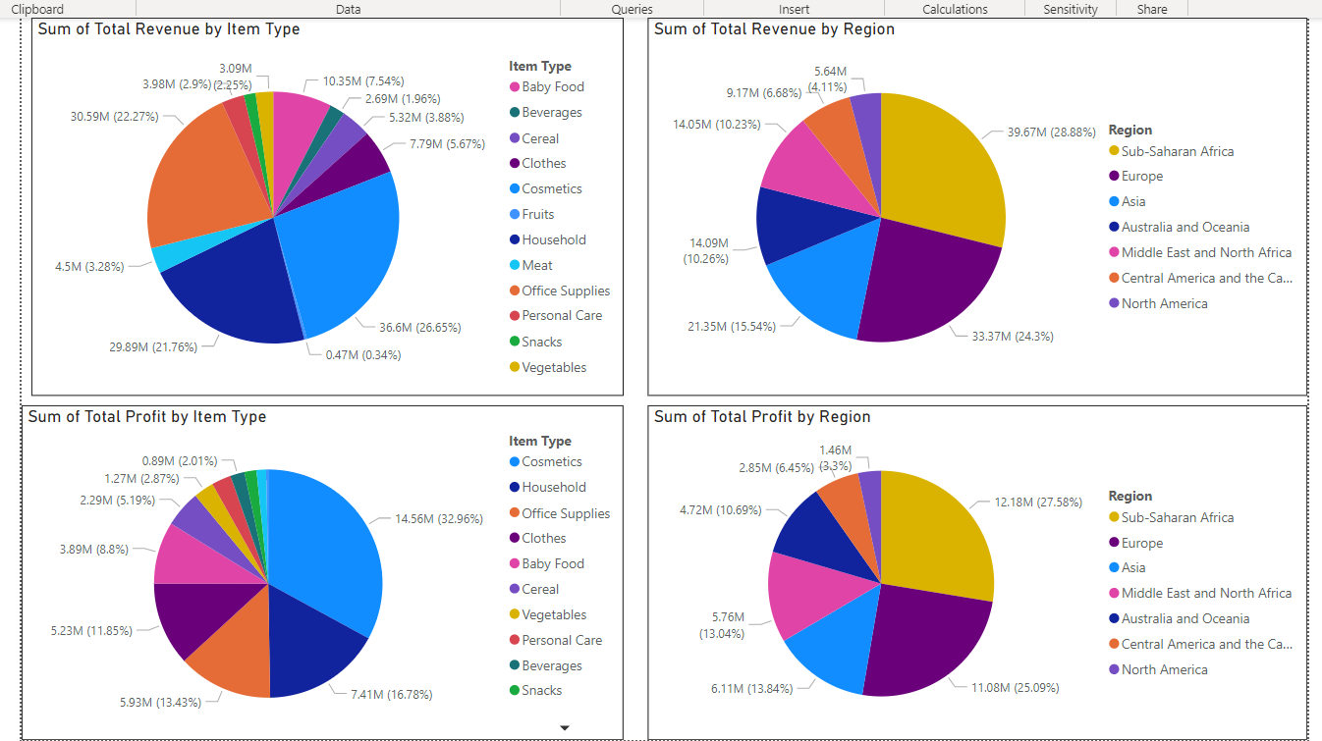
Results:
From this analysis we get information regarding total revenue & sum of profit by item wise

Slide 7
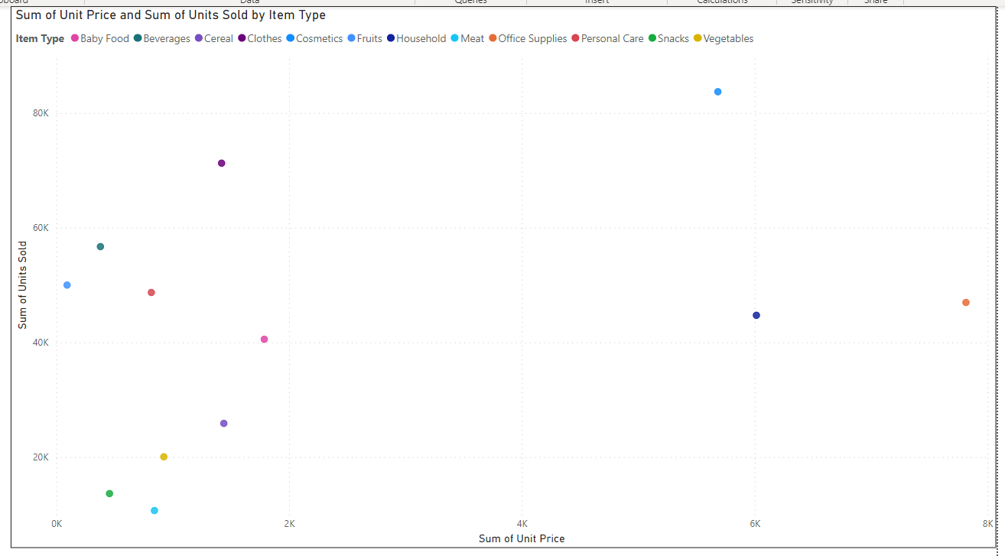
Results:
From this analysis we get information regarding unit sold & unit price.

Slide 8
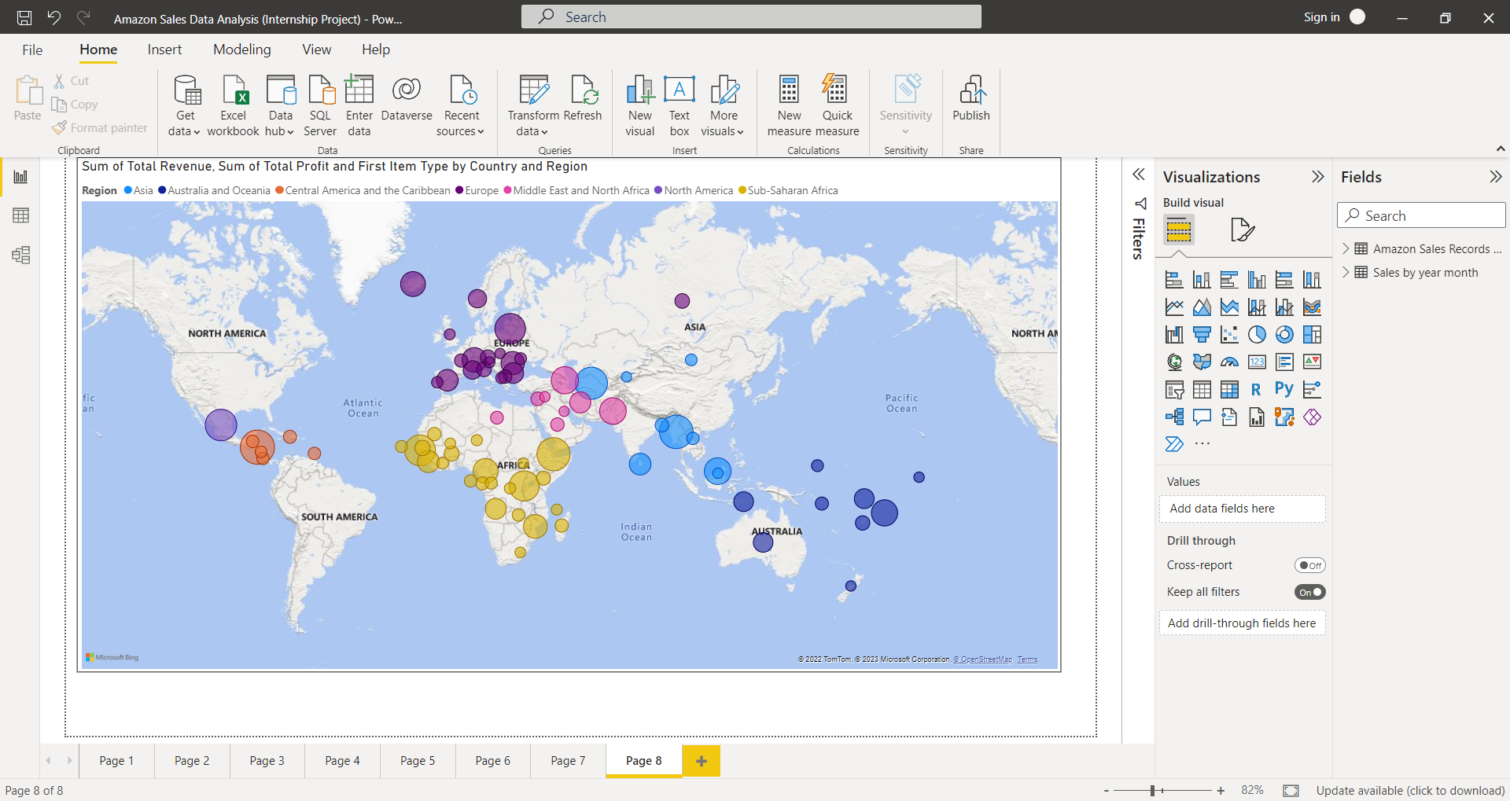
Results
From this analysis we can get information regarding Sum of total revenue, sum of total profit & first item type by country & region on map

Slide 9
Observation
From results we have observed that,
If analyse yearly, maximum revenue generated in year 2012, in year 2011 min revenue was generated. After generating peak revenue in year 2012 it was started decreasing up to year 2015. After year 2015 revenue was started to increase.
If analyse monthly year wise, Maximum revenue generated in the month of February , after that month of November takes second position. Remaining months generated average revenue.
If we analyse quarterly, Quarter 4 had generated maximum revenue.
Maximum revenue & profit is generated by cosmetics category, whereas minimum was generated by snacks, vegetables & beverages category.

Slide 10
If analyse region wise, maximum revenue & profit is generated by Sub – Saharan Africa whereas minimum was generated by North America.
If analyse on the basis of sales channel, cosmetic category revenue generated 50% on online & offline whereas in house hold category maximum revenue is generated on offline.
IF analyse on scatter plot, we observed that maximum units sold were from cosmetic category whereas maximum unit price was from office supply catagoy.

